Slide 1
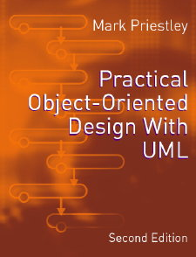
PRACTICAL
OBJECT-ORIENTED
DESIGN WITH UML
2e
Chapter 5:
Restaurant System: Analysis

Slide 2
Analysis
What is to be analyzed?
  the system requirements
Why?
  to demonstrate their implementability
How?
  by drawing interaction diagrams realizing use cases

Slide 3
Analysis v. Design
Difficult to draw a boundary
Traditional informal distinction:
  analysis models the real-world system
  design models the software
Object-oriented methods use the same notation for both activities
  encourages ‘seamless development’ and iteration

Slide 4
Object Design
We need to define attributes and operations for each class in the model
Start from domain model, but:
  structure of real-world application is not always the optimal structure for a software system
  domain model does not show operations
Realization identifies operations and confirms that design supports functionality

Slide 5
Object Responsibilities
Each class in a system should have well-defined responsibilities
  to manage a subset of the data in the system
  to manage some of the processing
The responsibilities of a class should be cohesive
  they should ‘belong together’
  they should form a sensible whole

Slide 6
Software Architecture
The UP analysis workflow includes the production of an architectural description
This defines:
  the top-level structure of subsystems
  the role and interaction of these subsystems
Typical architectures are codified in patterns
  for example, layered architectures

Slide 7
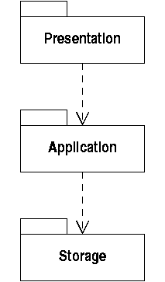
A Layered Architecture
Subsystems are shown as UML packages linked by dependencies
A dependency without a stereotype means uses

Slide 8
Separation of Concerns
Layers aim to insulate a system from the effects of change
For example, user interfaces often change
  but the application layer does not use the presentation layer
  so changes to system should be restricted to presentation layer classes
Similarly, details of persistent data storage are separated from application logic

Slide 9
Analysis Class Stereotypes
Within this architecture objects can have various typical roles
  boundary objects interact with outside actors
  control objects manage use case behaviour
  entity objects maintain data
These are represented explicitly in UML by using analysis class stereotypes

Slide 10
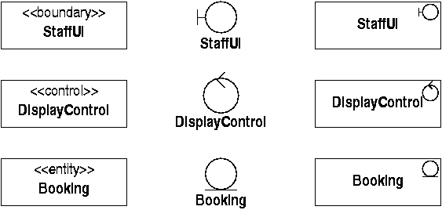
Class Stereotype Notation
Stereotypes can be text or a graphic icon
The icon can replace the normal class box

Slide 11
Use Case Realization
Begin with functionality in application layer
‘Display Bookings’: simple dialogue
  the user provides the required date
  the system response is to update the display
Initial realization consists of
  instance of the ‘Staff’ actor
  an object representing the system
  message(s) passed between them

Slide 12
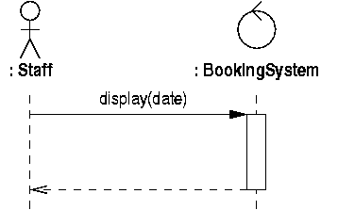
System Messages
System messages are sent by an actor
Represent system by a controller
  initially analysing use case behaviour, not I/O

Slide 13
Sequence Diagrams
Time passes from top to bottom
Instances of classes and actors at top
  only show those participating in this interaction
  each instance has a lifeline
Messages shown as arrows between lifelines
  labelled with operation name and parameters
  return messages (dashed) show return of control
  activations show when receiver has control

Slide 14
Accessing Bookings
How does the system retrieve the bookings to display?
Which object should have the responsibility to keep track of all bookings ?
  if this was an additional responsibility of the ‘BookingSystem’ object it would lose cohesion
  so define a new ‘Restaurant’ object with the responsibility to manage booking data

Slide 15
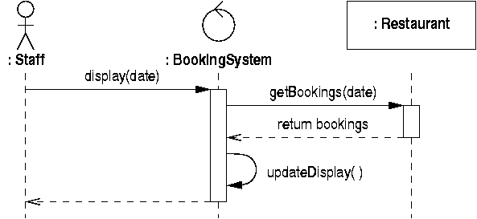
Retrieving Bookings
Add a message to get relevant bookings
‘updateDisplay’ is an internal message

Slide 16
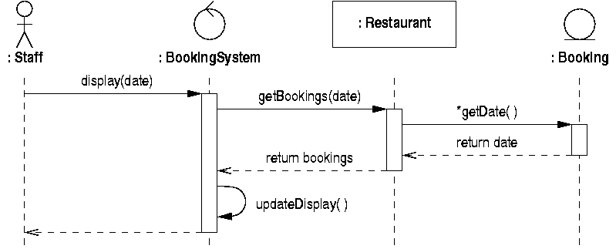
Retrieving Booking Details
Dates of individual bookings will need to be checked by the ‘Restaurant’ object

Slide 17
Refining the Domain Model
This realization has involved:
  new 'Restaurant' and 'BookingSystem' classes, with an association between them
  an association from ‘Restaurant’ to ‘Booking’
    ‘Restaurant’ maintains links to all bookings
    messages sent from restaurant to bookings
  an association from ‘BookingSystem’ to ‘Booking’
    ‘BookingSystem’ maintains links to currently displayed bookings

Slide 18
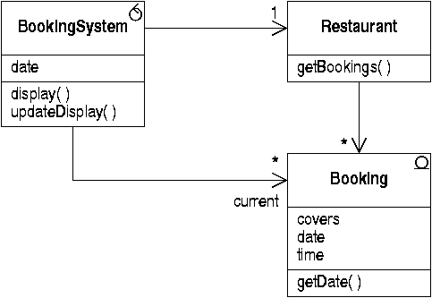
Updated Class Diagram
Operations are derived from messages sent to the instances of a class

Slide 19
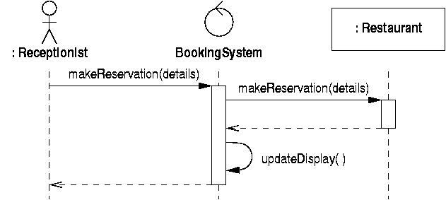
Recording New Bookings
Give ‘Restaurant’ responsibility for creation
  don’t model details of user input or data yet

Slide 20
Creating a New Booking
Bookings must be linked to table and customer objects
  responsibility of ‘Restaurant’ to retrieve these, given identifying data in booking details
New objects shown at point of creation
  lifeline starts from that point
  objects created by a message arriving at the instance (a constructor)

Slide 21
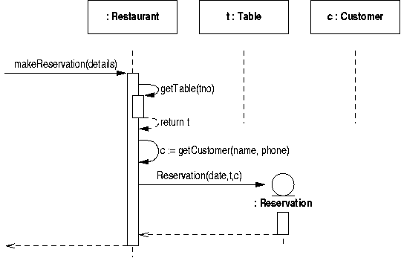
Creating a New Booking
This completes the previous diagram

Slide 22
Cancelling a Booking
A three-stage process:
  select on screen the booking to be cancelled
  confirm cancellation with user
  delete the corresponding booking object
Object deletion represented by a message with a ‘destroy’ stereotype
  lifeline terminates with an ‘X’
Role names used to distinguish selected object from others displayed

Slide 23
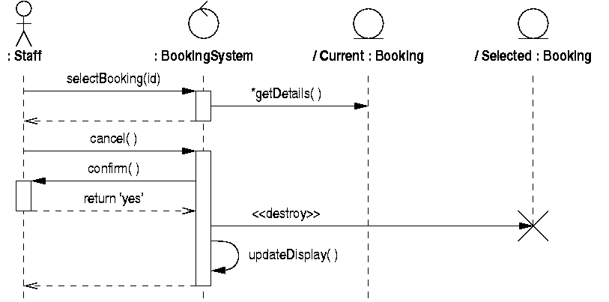
Cancelling a Booking

Slide 24
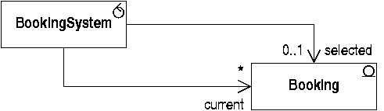
Refining the Domain Model (2)
‘BookingSystem’ has the responsibility to remember which booking is selected
Add an association to record this

Slide 25
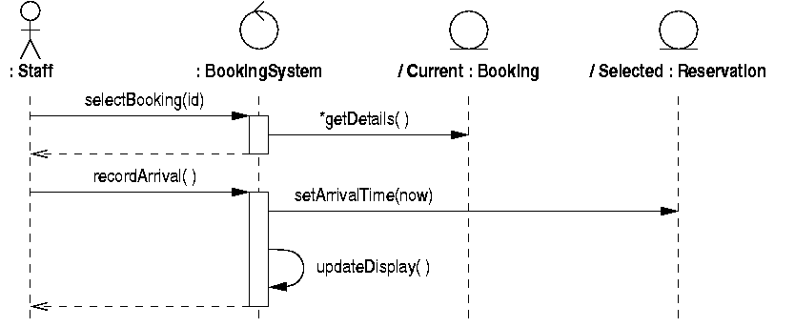
Recording Arrival
Selected booking must be a reservation

Slide 26
Class Interface Design
Should ‘setArrivalTime’ be defined in Booking or Reservation class?
  on the one hand, it doesn't apply to walk-ins
  but we want to preserve a common interface to all bookings if possible
Define operation in ‘Booking’ class
  default implementation does nothing
  override in ‘Reservation’ class

Slide 27
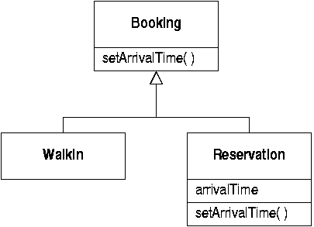
Refined Class Hierarchy

Slide 28
Summary
Analysis has led to:
  a set of use case realizations
  a refined class diagram
We can see how the class design is going to support the functionality of the use cases
This gives confidence that the overall design will work

Slide 29
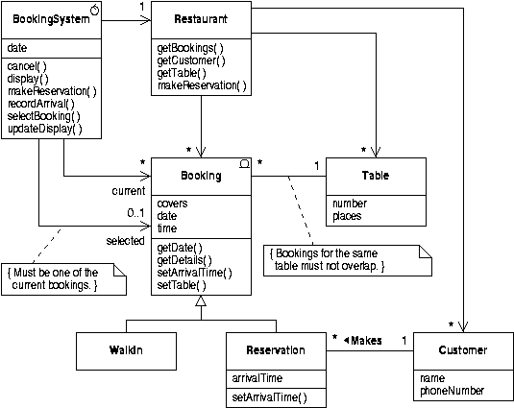
Complete Analysis Class Model

